Slide 1
AeroJump

Slide 2
Project Team
David Mitterlehner
Peter Elsigan

Slide 3
Project Idea
Jump 'n' Run game
Goal is to pass obstacles
Game speeds up with every passed obstacle
Collision with screen limits or obstacles stops the game

Slide 4
Features
How to Play
Scorer
Leaderboard
Game

Slide 5
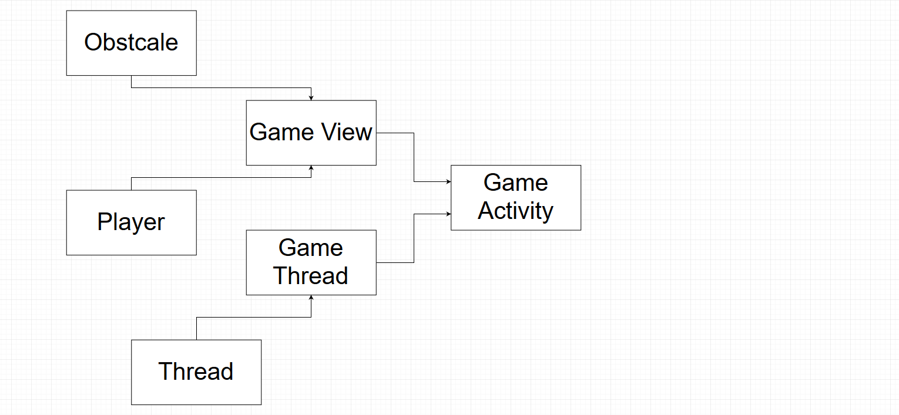
Block Diagram

Slide 6
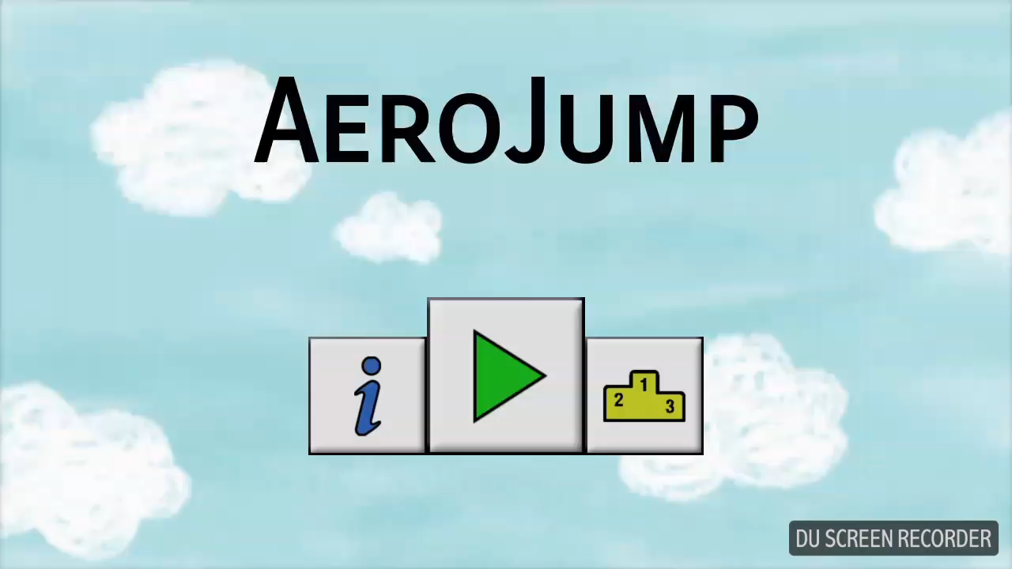
Short Demo

Slide 7

Cant install app right away?
Open it from a file manager and then install

